Slide 1
EE 441 Data Structures
Lecture 10: Sorting

Slide 2
Sorting
We need to do sorting for the following reasons :
By keeping a data file sorted, we can do binary search on it.
Doing certain operations, like matching data in two different files, become much faster.
There are various methods for sorting, having different average and worst case behaviors

Slide 3
Selection sort algorithm
n data items are stored in Array A
Make n-1 passes over the list
On pass 0:
select the smallest element in the list
exchange it with A[0]
Front of the list A[0] is ordered
Tail of the list A[1] to A[n-1] is unordered
On pass 1:
select the smallest element in the unordered tail list
exchange it with A[1]
Continue until n-1 passes

Slide 4
Selection sort algorithm
On pass 0:
select the smallest element in the list
exchange it with A[0]
Front of the list A[0] is ordered
Tail of the list A[1] to A[n-1] is unordered
Go on…
Example:
A=50,20,40,75,35
i=0: 20,50,40,75,35
i=1: 20,35,50,40,75
i=2: 20,35,40,50,75
i=3 : 20,35,40,50,75
i=4 : 20,35,40,50,75
Complexity?
Best case? Worst Case?

Slide 5
Selection sort algorithm complexity
Requires fixed number of comparisons that depend only on the size of the array not the distribution of the data
For general pass i sublist A[i+1] to A[n-1] is considered
number of comparisons for pass i: (n-1)- (i+1)=n-i-1
Total number of comparisons:
No best or worst case
Number of comparisons O(n²)

Slide 6
Selection sort algorithm
// sort A[0]..A[n-2], and A[n-1] is in place
for (i = 0; i < n-1; i++)
{
// start the scan at index i; set smallIndex to i
smallIndex = i;
// j scans the sublist A[i+1]..A[n-1]
for (j = i+1; j < n; j++)
// update smallIndex if smaller element is found
if (A[j] < A[smallIndex])
smallIndex = j;
// when finished, place smallest item in A[i]
Swap(A[i], A[smallIndex]);
}
}
template <class T>
void Swap (T &x, T &y)
{
T temp;
temp = x;
x = y;
y = temp;
}
// sort an array of n elements of type T using the
// selection sort algorithm
template <class T>
void SelectionSort(T A[], int n)
{
// index of smallest item in each pass
int smallIndex;
int i, j;

Slide 7
Radix Sort
Let's have the following 4-bit binary numbers. Assume there is no sign bit.
1010, (10)
0101, (5)
1011, (11)
0011, (3)
0110, (6)
0111 ,(7)
First begin with the LSB (least significant bit). Make two groups, one with all numbers that end in a "0" and the other with all numbers that end in a "1".
0:1010,0110
1:0101,1011,0011,0111
List after pass 1: 1010,0110 ,0101,1011,0011,0111

Slide 8
Radix Sort
Now, go to the next less SB and by examining the previous groups in order, form two new groups:
1010,0110 ,0101,1011,0011,0111
0:0101
1: 1010,0110,1011,0011,0111
List After pass2 :0101,1010,0110,1011,0011,0111

Slide 9
Radix Sort
Repeat the operation for the third bit from the right:
0:1010,1011,0011
1:0101,0110,0111
List after 3rd Pass:1010,1011,0011,0101,0110,0111
MSB:Pass:
0:0011,0101,0110,0111
1:1010,1011
Sorted List:0011,0101,0110,0111, 1010,1011
3,5,6,7,10,11
Complexity?
Best case? Worst Case?

Slide 10
Radix Sort: complexity
Each pass performs O(n) operations
For m digits: O(mn)
Disadvantage: Space use
For each digit it needs a separate queue
For practical purposes it cannot outperform O(nlogn) algorithms

Slide 11
Bubblesort
Array A with n elements
n-1 passes
Each pass we compare the adjacent elements
If first>second we exchange the elements
At the end of each pass: the largest element bubbles up to the top of the current list
After pass 0 is complete: the tail of the list A[n-1] is ordered and the front of the list remains unordered
We keep track of the index of the last exchanged element

Slide 12
Bubblesort
Example:
A=50,20,40,75,35
Pass 0:
Exchange 50,20
A=20,50,40,75,35
Exchange 50,40
A=20,40,50,75,35
Ordered: 50,75
Exchange 75,35
A=20,40,50,35,75
75 is the largest element: lastChangeIndex=3
lastChangeIndex is not 0 continue
Pass1:Scan the sublist A[0] to A[lastChangeIndex]=A[3]
Ordered: 20,40
Ordered: 40,50
Exchange 50,35
A=20,40,35,50,75
50 is the largest element: lastChangeIndex=2
lastChangeIndex is not 0 continue

Slide 13
Bubblesort
Pass2:Scan the sublist A[0] to A[lastChangeIndex]=A[2]
Ordered: 20,40
Exchange 40,35
A=20,35,40,50,75
40 is the largest element: lastChangeIndex=1
lastChangeIndex is not 0 continue
Pass3:Scan the sublist A[0] to A[lastChangeIndex]=A[1]
Ordered: 20,35
lastChangeIndex is 0 terminate
Complexity?
Best case? Worst Case?

Slide 14
Complexity of bubblesort
Best Case:
Bubblesort makes a single pass over a sorted list
Complexity is O(n)
Worst case:
Reverse ordered list
Makes n-1 passes
On pass i n-1-i comparisons and exchanges
Total: n(n-1)/2
O(n²)

Slide 15
BubbleSort Algorithm
// BubbleSort is passed an array A and list count n. it
// sorts the data by making a series of passes as long as
// lastExchangeIndex > 0.
template <class T>
void BubbleSort(T A[], int n)
{
int i,j;
// Index of last exchange
int lastExchangeIndex;
// i is the index of last element in the sublist
i = n-1;
// continue the process until no exchanges are made
while (i > 0)
{
// start lastExchangeIndex at 0
lastExchangeIndex = 0;
// scan the sublist A[0] to A[i]
for (j = 0; j < i; j++)
// exchange a pair and update lastExchangeIndex
if (A[j+1] < A[j])
{
Swap(A[j],A[j+1]);
lastExchangeIndex = j;
}
// set i to index of the last exchange. continue sorting
// the sublist A[0] to A[i]
i = lastExchangeIndex;
}
}

Slide 16
Merge Sort
In merge sort, two already sorted files are 'merged' to obtain a third file which is the sorted combination of the two sorted input files.
We begin by assuming we have n sorted files with size=1
Then,we merge these files of size=1 pairwise to obtain n/2 sorted files of size=2
Then,we merge these n/2 files of size=2 pairwise to obtain n/4 sorted files of size=4,etc..
Until we are left with one file with size=n.

Slide 17
Merge Sort
13
8
61
2
53
10
46
22
//merge two sorted filesto get a 3rd file
template <class T>
void merge(int m, int n, T *x, T *y, T*z)
{
int i,j,k,p;
i=0;//pointer to x
j=0;//pointer to y
k=0;//pointer to z
while (i<=m &&j<=n)
{
if(x[i]<=y[j])
{z[k]=x[i];
i++;}
else
{z[k]=y[j];
j++;}
k++;
}
if(i>m)
for p=i;p<m;p++)
{z[k]=y[p];
k++;}
else
for p=i;p<m;p++)
{z[k]=x[p];
k++;}
}
8
13
2
61
10
53
22
46
2
8
13
61
10
22
46
53
2
8
10
13
22
46
53
61
3 files:
x: size m
y: size n
z: size n

Slide 18
Merge Sort: Complexity
Series of passes that begin with one element sub-lists
Each pass doubles the size of the sub-lists until their size ≥n
This requires log₂n passes
Each pass all n elements are copied to temporary files and copied back
Total O(nlogn)

Slide 19
Quick sort algorithm
Fastest know sorting algorithm
Partition approach to sort a list
Main Idea:
Determine a pivot value to split the list into two parts
Split the list into two parts according to the pivot
Items smaller than the pivot goes into left list
Items larger than the pivot goes into left list
For each part and repeat the same procedure

Slide 20
Quick sort algorithm: Example
A=550,150,300,600,800,650,400,350,450,700
The pivot: A[0]=550
2 sublists : Sl ≤pivot, Sh >pivot

Slide 21
Quick sort algorithm: Implementation
Two variables: ScanUp, ScanDown
ScanUp:
responsible for locating the elements in sublist Sl
Initially: set at low+1=1
ScanDown:
responsible for locating the elements in sublist Sh
Initially: set at high=9
Each pass identifies the elements in each of the sublists

Slide 22
Quick sort algorithm: Implementation Example
Each pass identifies the elements in each of the sublists
ScanUp searches the lower list. It moves up to look for A[scanup]>pivot
ScanDown searches the upper list. It moves down to lookfor A[scandown] ≤ pivot
Those two elements are in wrong sublists so exchange them: Swap(A[scanup],A[scandown])
Continue until ScanUp and ScanDown pass each other
Example: Scan Phase: Pivot:550
550,150,300,600,800,650,400,350,450,700
ScanUp=600:A[3]
ScanDown=450:A[8]
550,150,300,600,800,650,400,350,450,700 ➔Swap
After Swap: 550,150,300,450,800,650,400,350,600,700

Slide 23
Quick sort algorithm: Implementation Example
Scan: 550,150,300,450,800,650,400,350,600,700
ScanUp=800:A[4]
ScanDown=350:A[7] ➔ Swap
Scan: 550,150,300,450,350,650,400,800,600,700
ScanUp=650:A[5]
ScanDown=400:A[6] ➔ Swap
Scan:550,150,300,450,350,400,650,800,600,700
ScanUp and ScanDown pass eachother at ScanUp=A[6] ScanDown=A[5]➔ they enter into the list they belong
ScanDown separates the list
Put Pivot in the middle: Exchange A[0] and A[ScanDown]
Resulting list:400,150,300,450,350,550,650,800,600,700
Sl=A[0]-A[4], Sh=A[6]-A[9]

Slide 24
Quick sort algorithm
Use recursion to process the sublists:
locate the pivot to split the list
Recursive part Call with parameters: low to mid-1 and mid+1 to high
Stopping condition: when a sublist has 0 or 1 element (an ordered list)

Slide 25
Quick sort algorithm: Example
Recursive phase:
Sl:400,150,300,450,350
Sh: 650,800,600,700
Sl: low=0, high=4, pivot: 400
look for A[scanup]>pivot A[scandown] ≤ pivot
400,150,300,450,350
ScanUp=450:A[3]
ScanDown=350:A[4]
Swap: 400,150,300,350,450
ScanUp passed ScanDown Halt the process
Exchange pivot and ScanDown
350,150,300,400,450

Slide 26
Quick sort algorithm
Template <classT>
void qsort(T *A, int low, int high)
{//quick sort
T pivot, temp;
if (low<high) {
int ScanUp=low+1;
int ScanDown=high;
pivot=A[low];
while (true)
{ while (A[ScanUp] <=pivot) {ScanUp++};
while (A[ScanDown] >pivot) {ScanDown--};
if (ScanUp<ScanDown)
{temp=A[Scandown];//swap A[ScanDown] and A[ScanUp]
A[ScanDown]=A[ScanUp];
A[ScanUp]=temp;}
else break;
}//end of while (true)

Slide 27
Quick sort algorithm
//swap A[ScanDown] and A[low]
A[low]=A[ScanDown];
A[ScanDown]=pivot;
//Recursive calls
qsort(A,low,ScanDown-1);
qsort(A, ScanUp+1,high);
}//end of if low<high
}

Slide 28
Complexity: Quick sort algorithm
Assumption: n=2k, k=log2n
Average case/Best Case:
Pivot lies in the middle of the list so sub-lists are of equal size
First scan:
n-1 comparisons (from two sides of the list)
Sublists have size n/2
Second scan:
Each sublist have n/2 comparison: total comparison=2*n/2=n
Eventually the splitting terminates after k passes, each pass with n comparisons
Average O(nlogn)

Slide 29
Complexity: Quick sort algorithm
Worst case:
pivot always falls in a one-element sublist
Leaves the rest in the second sub-list
Pivot is always the smallest element in the sub-list
First scan: 1,n-1
Second scan:2, n-2
Comparisons n+n-1+n-2+…+2=n(n+1)/2
O(n²)

Slide 30
Sorting
 | Average | Worst
Bubble sort | O(n²) | O(n²)
Quick sort | O(nlogn) | O(n²)
Heap sort | O(nlogn)

Slide 31
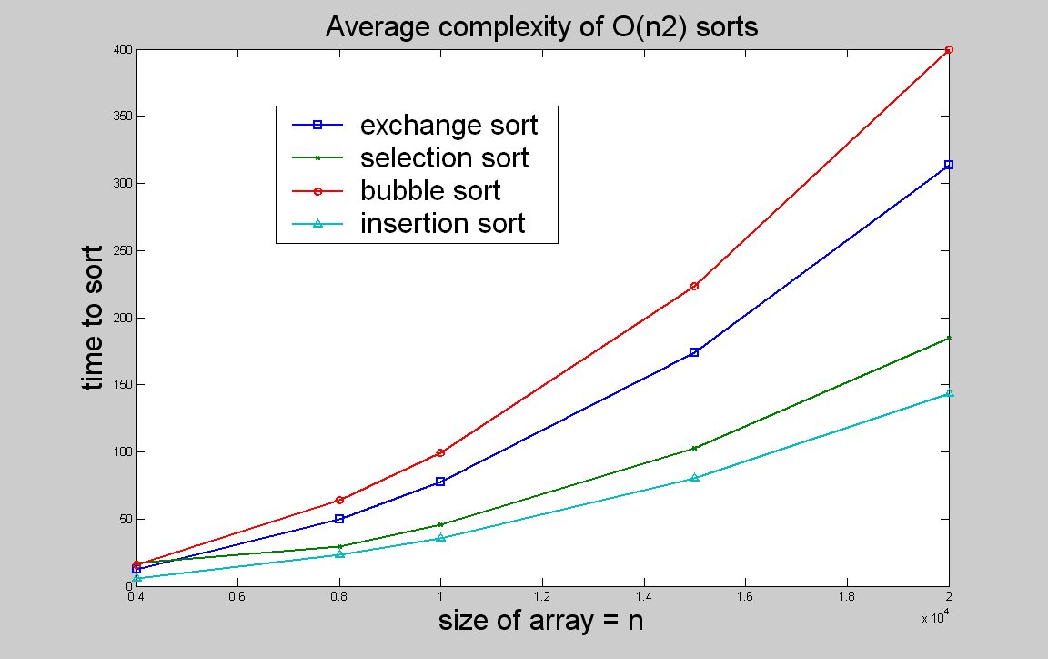
Comparison of algorithms
n | 4000 | 8000 | 10000 | 15000 | 20000
exchange sort | 12.23 | 49.95 | 77.47 | 173.97 | 313.33
selection sort | 17.3 | 29.43 | 46.02 | 103 | 185.05
bubble sort | 15.78 | 64.03 | 99.1 | 223.28 | 399.47
insertion sort | 5.67 | 23.15 | 35.43 | 80.23 | 143.67
quick sort | 0.07 | 0.17 | 0.22 | 0.33 | 0.47

Slide 32
EE 441 Data Structures
Lecture 10: Sorting

